Slide 1


K-12 Demographic Change
The implications of declining Enrollment on the State’s Traditional K-12 Systems
January 16th, 2025
COMMON SENSE INSTITUTE ARIZONA

Slide 2
We believe sound fiscal
and economic research
is essential to uphold Arizona's economy,
vitality, future, and
individual opportunity.

Slide 3

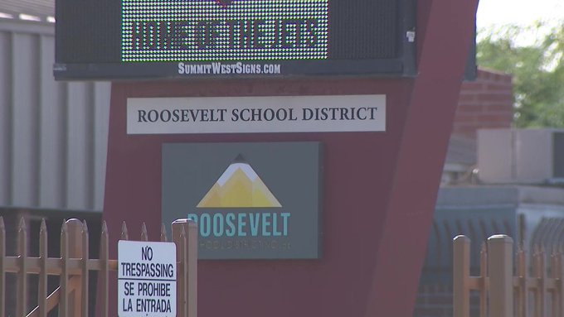
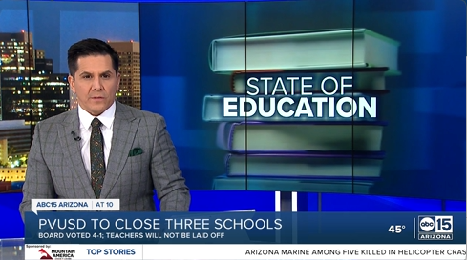
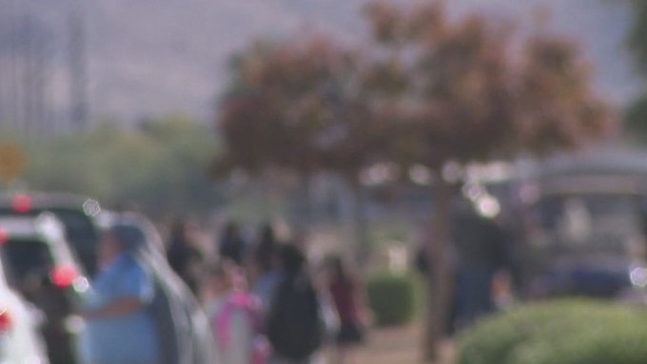
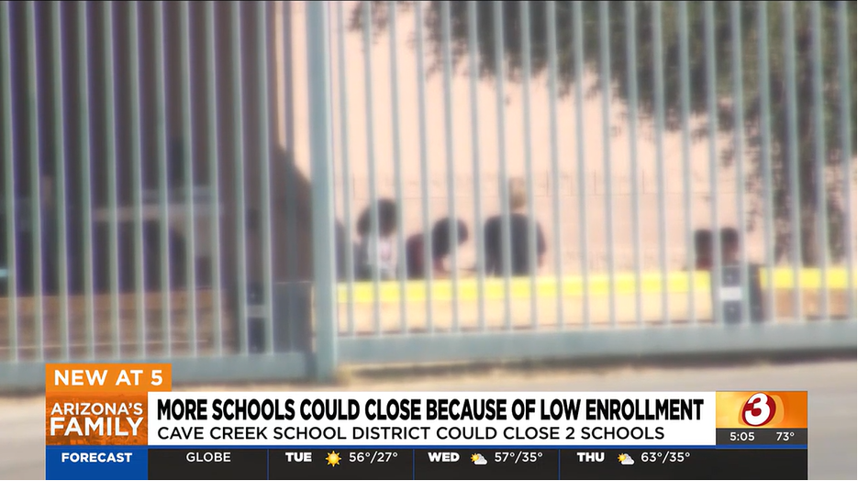
Common Sense Institute
K-12 Demographic Change
FOX10 Dec 2024: Roosevelt School District votes to close 5 schools
ABC15 Feb 2024: Three Paradise Valley schools to close as enrollment numbers decline
FOX10 Nov 2024: Changing demographics appear to be lowering Arizona public school enrollment
AZFamily Dec 2024: Cave Creek Unified proposes closing 2 schools amid dropping enrollment

Slide 4
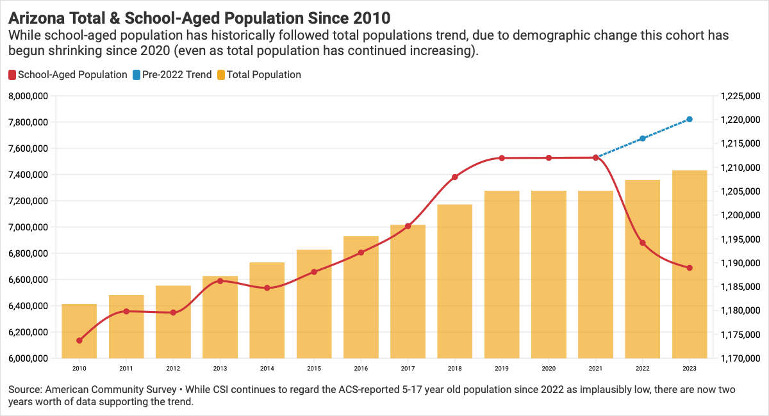
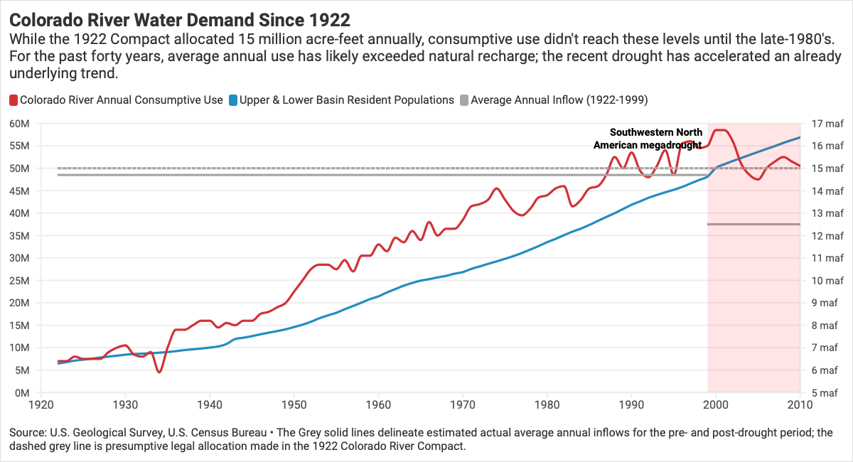
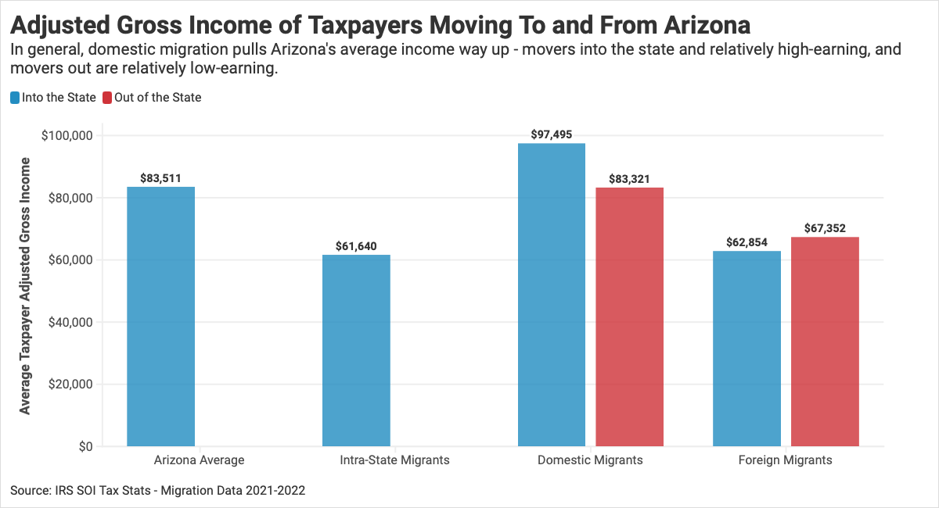
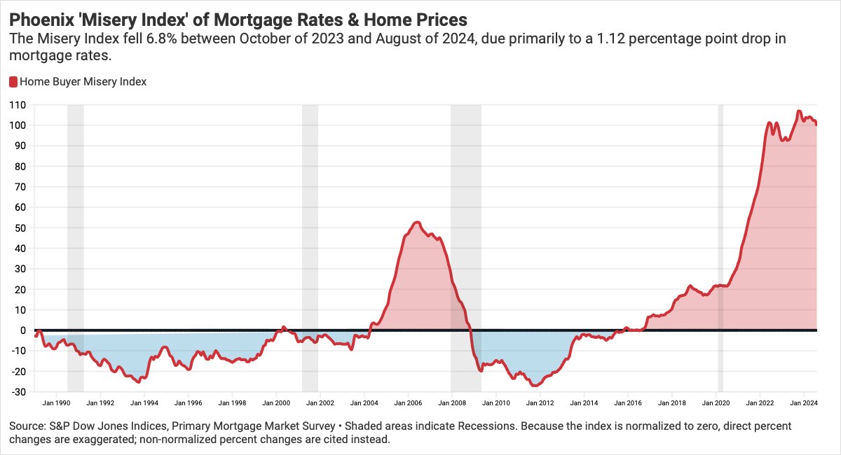
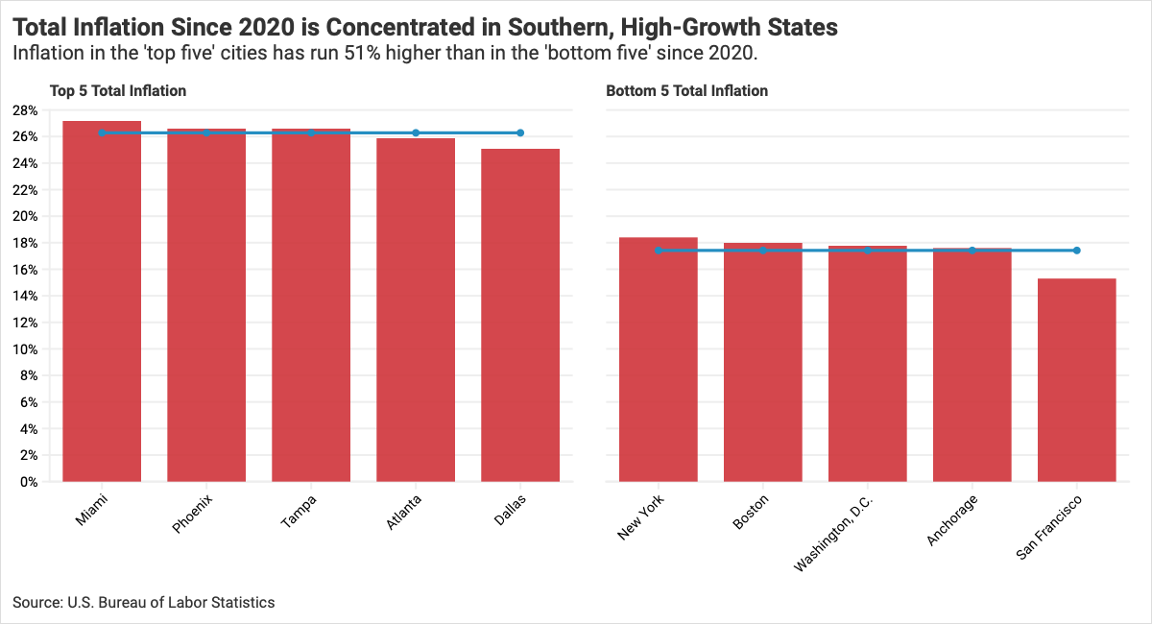
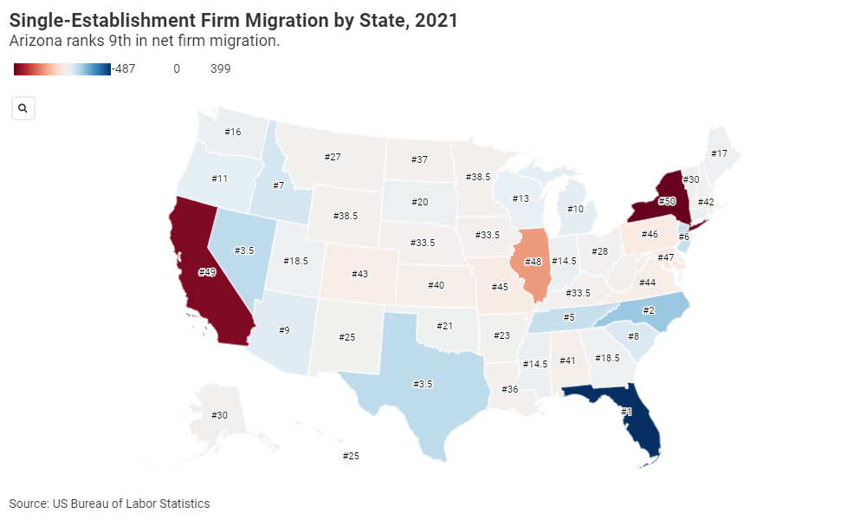
Common Sense Institute
K-12 Demographic Change
Demographic Change Is No Longer a Future Problem
COMMON SENSE INSTITUTE ARIZONA

Slide 5
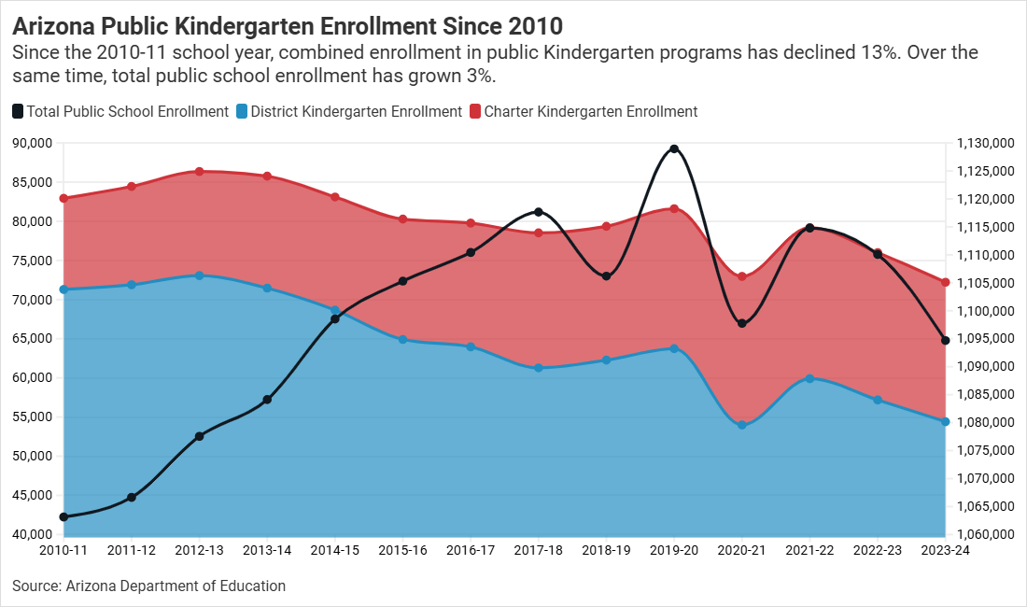
Common Sense Institute
K-12 Demographic Change
Demographic Change Is No Longer a Future Problem
COMMON SENSE INSTITUTE ARIZONA

Slide 6
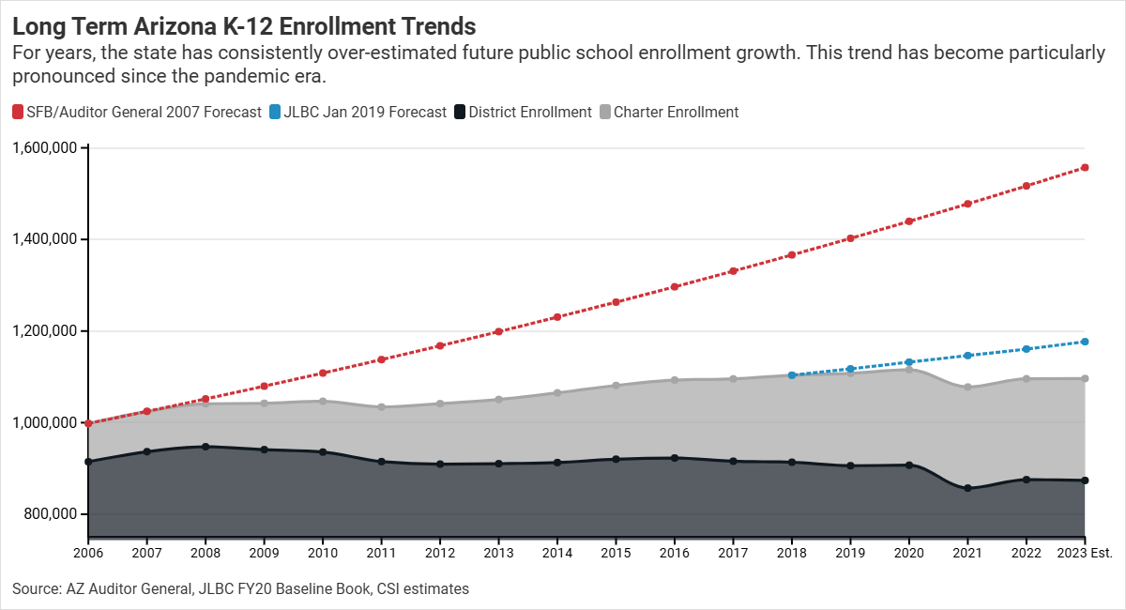
Common Sense Institute
K-12 Demographic Change
District Schools Haven't Grown Since 2008
COMMON SENSE INSTITUTE ARIZONA

Slide 7
Common Sense Institute
K-12 Demographic Change
Demographic Decline Alone Doesn’t Explain the Pace of Change
The pandemic dramatically changed school enrollment preferences. Nationwide:
COMMON SENSE INSTITUTE ARIZONA

Slide 8
Common Sense Institute
K-12 Demographic Change
Demographic Decline Alone Doesn’t Explain the Pace of Change
The pandemic dramatically changed school enrollment preferences. Nationwide:
Charter school enrollment nearly doubled between 2020-2022
COMMON SENSE INSTITUTE ARIZONA

Slide 9
Common Sense Institute
K-12 Demographic Change
Demographic Decline Alone Doesn’t Explain the Pace of Change
The pandemic dramatically changed school enrollment preferences. Nationwide:
Charter school enrollment nearly doubled between 2020-2022
55% of surveyed private schools reported enrollment growth in SY 2021
COMMON SENSE INSTITUTE ARIZONA

Slide 10
Common Sense Institute
K-12 Demographic Change
Demographic Decline Alone Doesn’t Explain the Pace of Change
The pandemic dramatically changed school enrollment preferences. Nationwide:
Charter school enrollment nearly doubled between 2020-2022
55% of surveyed private schools reported enrollment growth in SY 2021
Homeschooling went from 2% of the K-12 population to 11% during the pandemic; come down but still over 6% even today
COMMON SENSE INSTITUTE ARIZONA

Slide 11
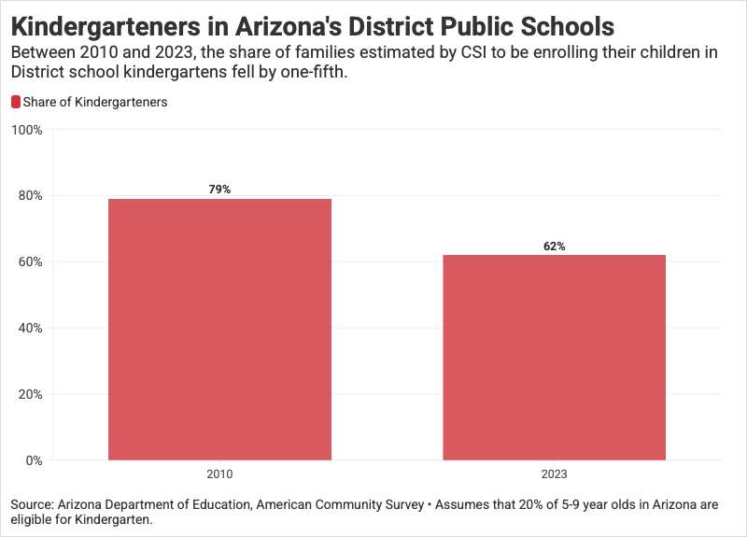
Common Sense Institute
K-12 Demographic Change
Demographic Decline Alone Doesn’t Explain the Pace of Change
The pandemic dramatically changed school enrollment preferences. Nationwide:
Charter school enrollment nearly doubled between 2020-2022
55% of surveyed private schools reported enrollment growth in SY 2021
Homeschooling went from 2% of the K-12 population to 11% during the pandemic; come down but still over 6% even today
COMMON SENSE INSTITUTE ARIZONA

Slide 12
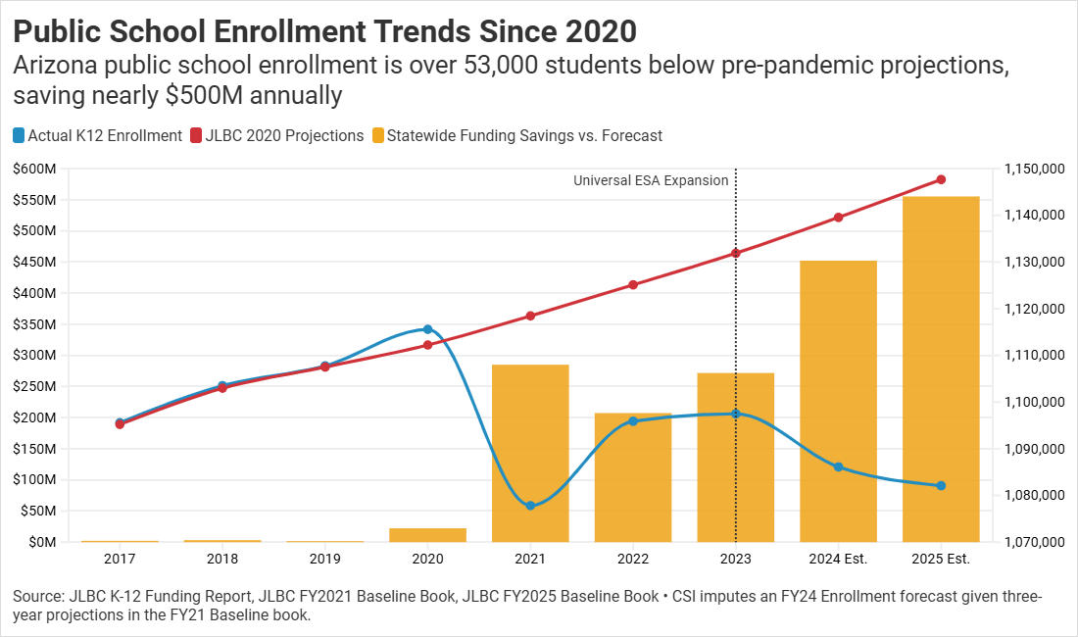
Common Sense Institute
K-12 Demographic Change
Funding Formulas Make These Enrollment Declines Fiscally Relevant
COMMON SENSE INSTITUTE ARIZONA

Slide 13
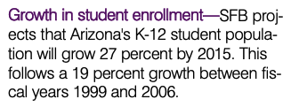
Common Sense Institute
K-12 Demographic Change
We Designed & Built A System for A Different World
COMMON SENSE INSTITUTE ARIZONA

Slide 14
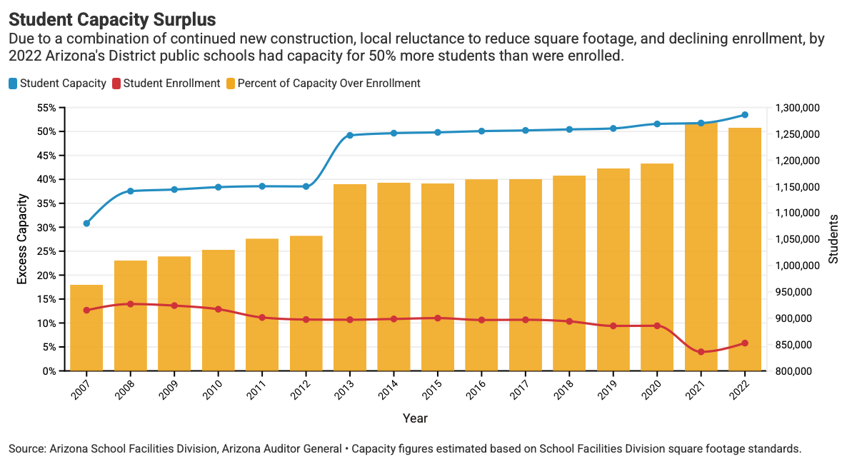
Common Sense Institute
K-12 Demographic Change
We Designed & Built A System for A Different World
COMMON SENSE INSTITUTE ARIZONA

Slide 15
Common Sense Institute
K-12 Demographic Change
We Designed & Built A System for A Different World
COMMON SENSE INSTITUTE ARIZONA

Slide 16
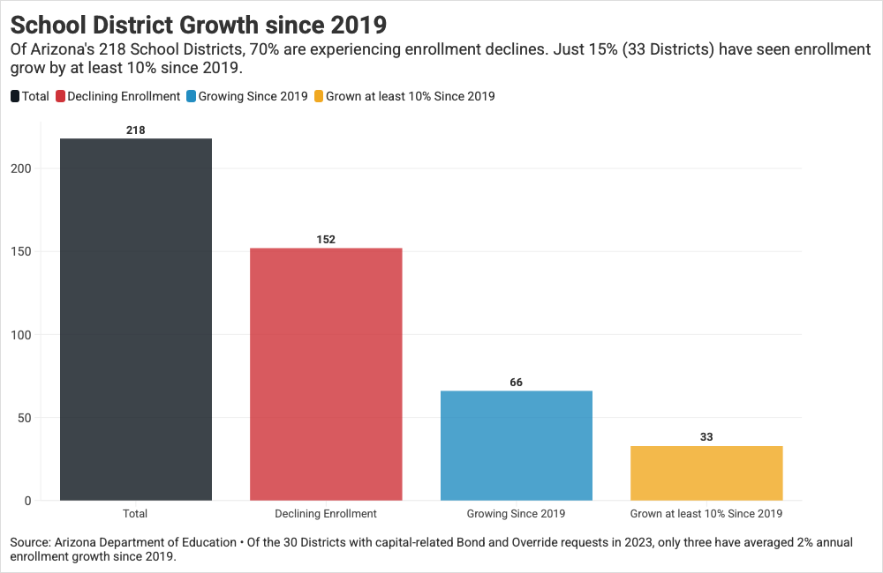
Common Sense Institute
K-12 Demographic Change
We Designed & Built A System for A Different World
COMMON SENSE INSTITUTE ARIZONA

Slide 17
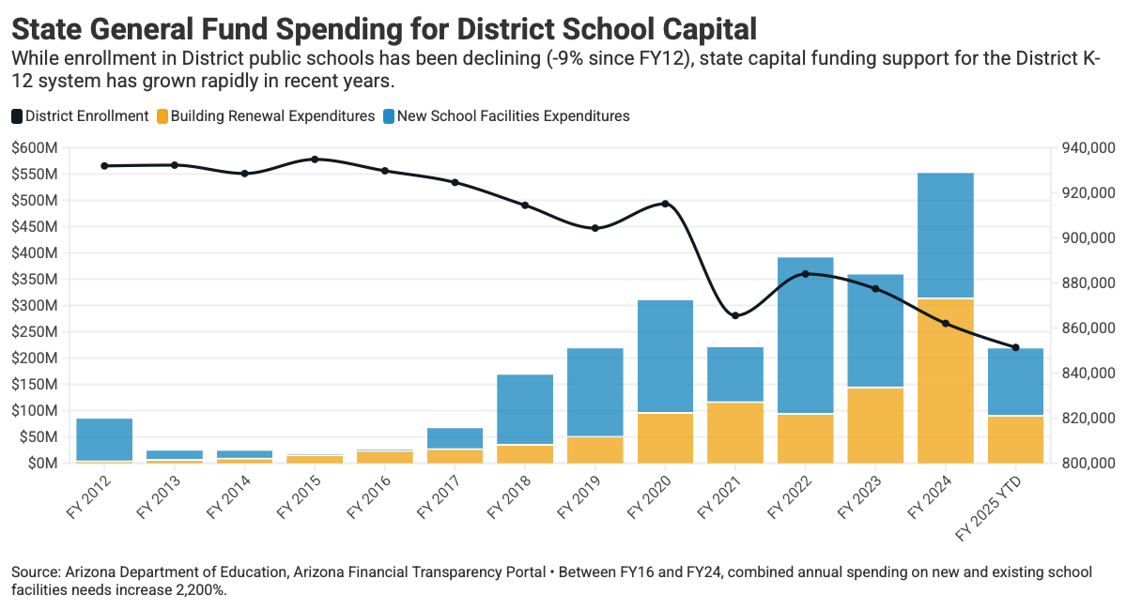
Common Sense Institute
K-12 Demographic Change
We Are Still Funding The System We Designed
COMMON SENSE INSTITUTE ARIZONA

Slide 18
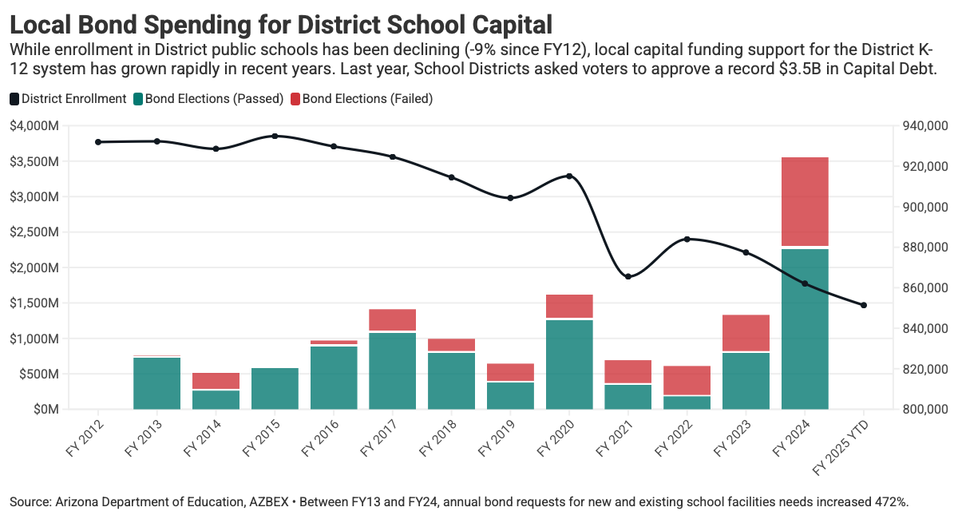
Common Sense Institute
K-12 Demographic Change
We Are Still Funding The System We Designed
COMMON SENSE INSTITUTE ARIZONA

Slide 19
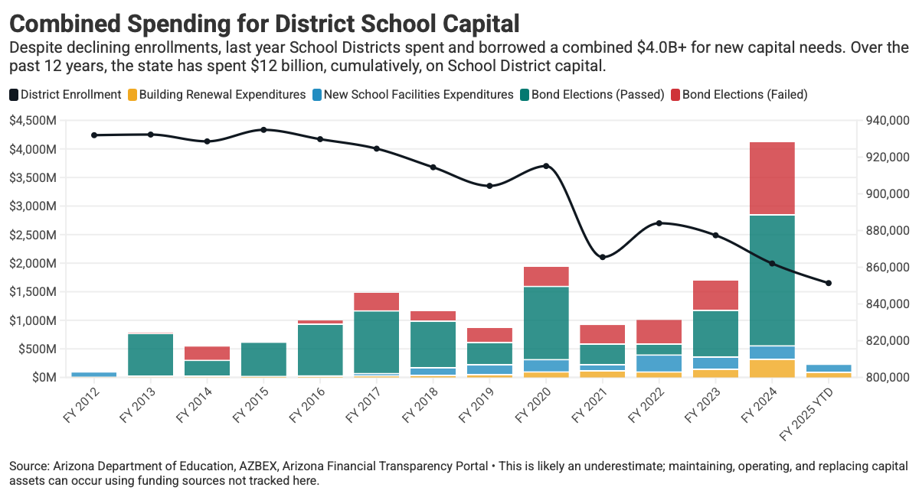
Common Sense Institute
K-12 Demographic Change
We Are Still Funding The System We Designed
COMMON SENSE INSTITUTE ARIZONA

Slide 20
Common Sense Institute
K-12 Demographic Change
Don’t We Still Need to Fund For Some Growth?
COMMON SENSE INSTITUTE ARIZONA

Slide 21
Common Sense Institute
K-12 Demographic Change
Don’t We Still Need to Fund For Some Growth?
19,922: Gross enrollment increase since 2019 at growing Districts.
COMMON SENSE INSTITUTE ARIZONA

Slide 22
Common Sense Institute
K-12 Demographic Change
Don’t We Still Need to Fund For Some Growth?
19,922: Gross enrollment increase since 2019 at growing Districts.
$29,568: Avg. per-student cost of a new school (2023 SFB)
COMMON SENSE INSTITUTE ARIZONA

Slide 23
Common Sense Institute
K-12 Demographic Change
Don’t We Still Need to Fund For Some Growth?
19,922: Gross enrollment increase since 2019 at growing Districts.
$29,568: Avg. per-student cost of a new school (2023 SFB)
$589M: Gross new facilities funding needed, SY 2019-2024
COMMON SENSE INSTITUTE ARIZONA

Slide 24
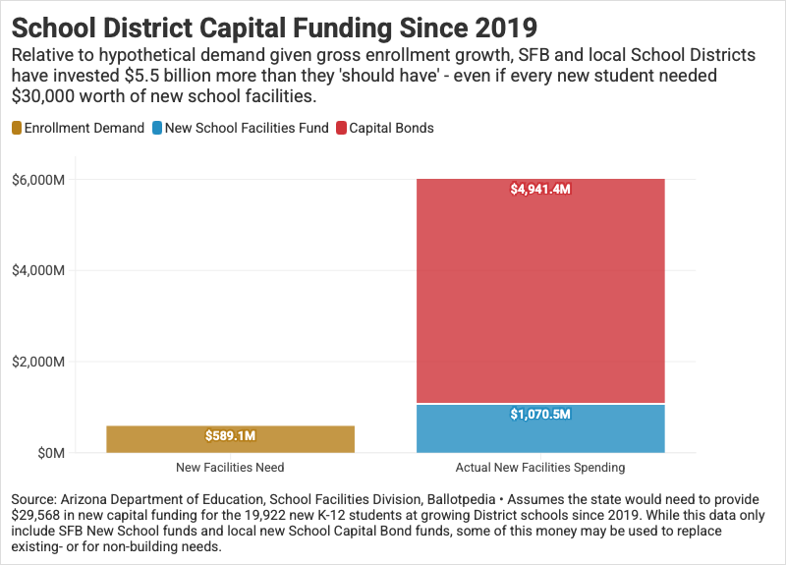
Common Sense Institute
K-12 Demographic Change
Don’t We Still Need to Fund For Some Growth?
19,922: Gross enrollment increase since 2019 at growing Districts.
$29,568: Avg. per-student cost of a new school (2023 SFB)
$589M: Gross new facilities funding needed, SY 2019-2024
COMMON SENSE INSTITUTE ARIZONA

Slide 25
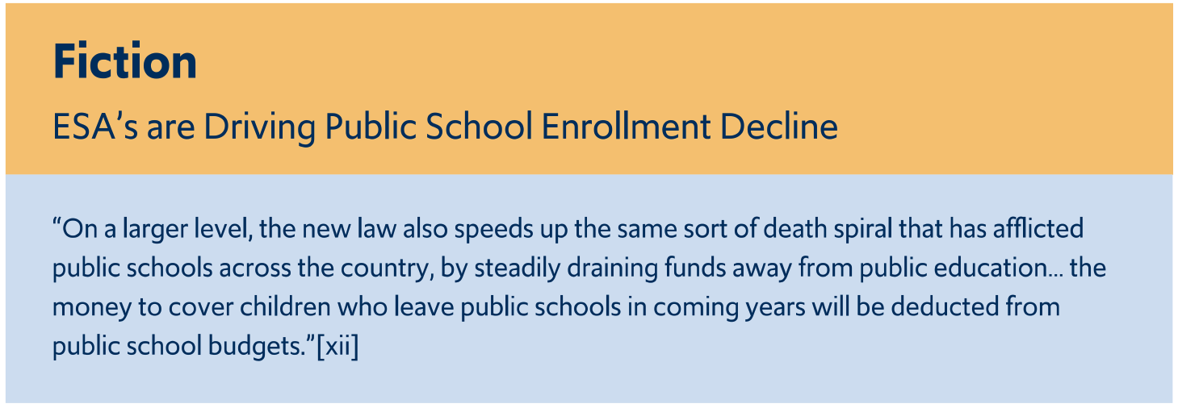
Common Sense Institute
K-12 Demographic Change
Where Do Universal ESA’s Fit?
COMMON SENSE INSTITUTE ARIZONA

Slide 26
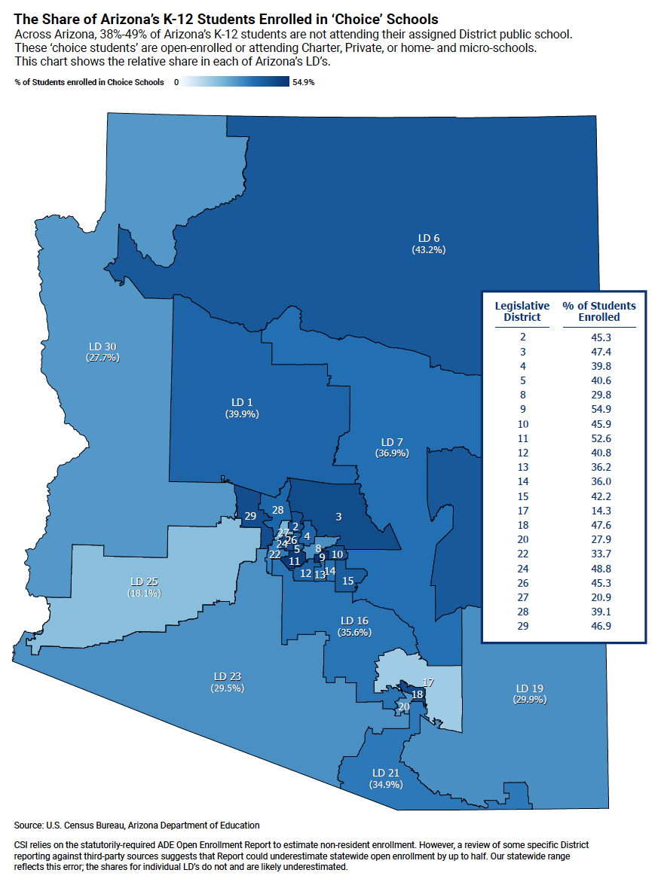
Common Sense Institute
K-12 Demographic Change

Slide 27
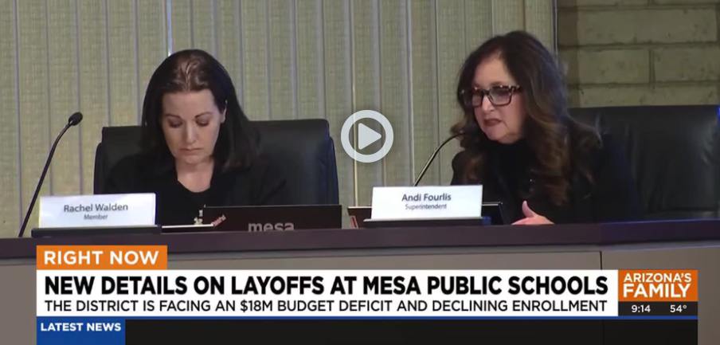
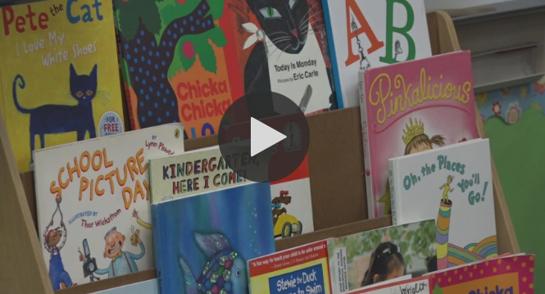
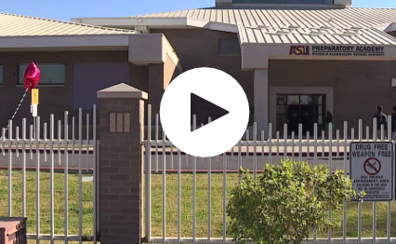
Common Sense Institute
K-12 Demographic Change
Where Is This Leading Us?
AZFamily Jan. 2025: ‘It’s Heartbreaking’: Teachers react to Mesa Public Schools upcoming layoffs
12News Jan 2023: Arizona Bond and override elections lead to disparities in school funding
ABC15 Jan 2025: Phoenix Elementary School District votes not to renew lease for ASU Prep

Slide 28

QUESTIONS?
COMMONSENSENINSTITUTEAZ.ORG

